Slide 1
Model Evaluation in Action
DATA 6545: Data Science & MLOps
Dr. Jie Tao
Fairfield Dolan

Slide 2
Eventually, what are we evaluating?
Accuracy?
F1, AUC?
Something else?
Q: Do you remember what is the definition of true positives/negatives?

Slide 3
Validation vs. Test

Slide 4
Purpose of Validation
Select the BEST model
Best model means:
Best modeling algorithm (LR vs. DT vs. RF …)
Best implementation of the model (hyperparameters)
Keep in mind validation is part of your training data
So validation results are NOT performance of your model
Recommendation: select top-k (3) rather than the top-1 model
Rationale: Everyone likes to read a little comparison

Slide 5
Purpose of Testing
Demonstrate that your model can perform okay on new, unseen data
Make sure the test data was never used in training of the model
Split the data (train/test) at the beginning of the pipeline (refer to the data leakage slides for help)
Recommendations:
Apply the selected top-k models on the test results
Get the metrics (acc, f1, mae, …)
Explain what the metrics means based on the analytical problem (value)

Slide 6
Tips for Validation
Instance wise:
CV is a common practice
Because of CV, bias/variance makes sense
Low bias low variance means the best model
If you have to choose, choose low variance → meaning your model will perform better on new data
Feature wise:
Feature selection is a must
Really think about if a feature is needed (OHE!!!)
Bootstrapping

Slide 7
Bootstrapping Explained
Aka. ‘sensitivity analysis’
Meaning add 1 at a time
Usually means include 1 more feature in the modeling at a time
How is it done?
Select more than the optimal number of features
E.g., if feature selection suggests 10 features, you select 11/12
Ranking features based on their importance (descending)
Votes/feature importance/correlation to target
Adding 1 feature at a time in order
When performance does not improve anymore, STOP
Line chart is best to show trend of performance (elbow method)
Can be used for model optimization as well

Slide 8
Tips for Testing
Sometimes you need multiple test sets
Normally you don’t but for rigorous testing you do
Testing on a set vs. on individual samples
We normally test our selected model on a set
So we can calculate metrics → be careful selecting metrics
Metrics are NOT results → you have to explain the results
Why test on individual samples?
Typically use them as examples → communication, slides
Shed some lights on model behavior (correct/wrong)
Earn trust of client/stakeholders
You can select a few samples from your test set

Slide 9
Evaluation Metrics

Slide 10
The Ultimate Metric
Loss, aka. Error
All models suffer from information loss
However for different problem we have different way to measure it
Loss = y - y_hat
But it can in the form of accuracy, f1, log-loss, mae, …
Select the proper one based on your problem → if it’s regression don’t select accuracy, nor AUC for multi-class classification
The purpose of training →
Minimize training loss
Lower training loss → lower testing loss
Expect to see testing loss >= training loss
Sometimes we have to customize our own loss function

Slide 11
Overfitting/Underfitting Reviewed
Training loss << testing loss → overfitting
Data leakage?
More data?
Different model?
Wrong problem?
Training loss >> testing loss → underfitting
Keep training/optimizing …

Slide 12
Probabilistic Metics - usually used for reg. Models
AIC is the measure of information loss.
K: number of features, L: 1 - loss, N: size of training set
Downfall: easy to overfit
BIC was derived from the Bayesian probability concept and is suited for models that are trained under the maximum likelihood estimation.
Similar parameters to AIC
Downfall: not performing well w/ small datasets
Minimum Description Length (MDL)
Structural Risk Minimization (SRM)

Slide 13
Classification metrics
Accuracy: most direct, most biased
Only use it for some quick check of the models
Precision: when false positive have high costs
e.g. , maintenance of machine, COVID tests
Recall: when finding true positive is most important
E.g., fraud detection → you want every detected fraud is indeed fraudulent
Best of both worlds: f1 score
If you cannot decide precision/recall, go with f1
F1 is good with multi-class problems → macro average

Slide 14
Classification Metrics - cont’d
AUC-ROC:
Used when you want to rank model performances
Require your data is not heavily imbalanced
Usually used with binary classification problems
Negative Log Loss (NLL)
-log(loss)
Very preferred with neural networks
Gain and Lift Charts: test/evaluate model on portions of data
K-S Chart: determines difference in distributions of y and y_hat
QUESTION: which metric you will use for project 2? Why?

Slide 15
AUC in Spotlight
Mostly (!) used in binary classification problems
At (0,0), every instance is classified as negative;
At (1,1), every instance is classified as positive.
If the data is balanced, the diagonal line (0,0) to (1,1) represents random guessing
AUC means the area between the model curve and random guessing
Higher AUC means model with good skills
Numeric example:
Say we have an .8546 AUC, that means the model can tell an instance belongs to the positive or the negative class 85.46% of the time
AUC is a good metric used for model selection, whereas F1 is more suitable for communicating your results
AUC suffers if your dataset is imbalanced (Use PR curve instead)
If you have to, you can calculate per-class or macro-/micro-averaged ROC in multiclass classification problems

Slide 16
Regression Metrics
MSE/RMSE: easy to calculate/interpret, prone to outliers
MAE: more resistant to outliers
Without compare MSE/RMSE/MAE to the range of your target, it does NOT make any sense
R-squared: variance of target explained by model
Downfall: even adding random features will improve R2 → overfitting
Adjusted-R2: Penalizes model when more features added

Slide 17
Clustering Metric
Silhouette Coefficient tracks how every point in one cluster is close to every point in the other clusters in the range of -1 to +1.:
Higher Silhouette values (closer to +1) indicate that the sample points from two different clusters are far away.
0 indicates that the points are close to the decision boundary
and values closer to -1 suggests that the points have been incorrectly assigned to the cluster.

Slide 18
Quick notes about Metric Selection
Selecting the most appropriate evaluation metric can be overwhelming - even for seasoned data scientists
Sometimes you have to let the context/analytical problem to guide you
Relying on multiple individual examples from models can be insightful
If two people make recommendations like those, who would you trust/hire? Why?

Slide 19
Trade-offs in ML

Slide 20


Precision-Recall Tradeoff
What does precision mean?
For all the instance predicted to be belonging to a class, how many of them actually belong to the class?
What does recall mean?
How many of the instances belong to the class were predicted accurately?
y’\y | 1 | 0
1 | 1 | 1
0 | 8 | 90

Slide 21
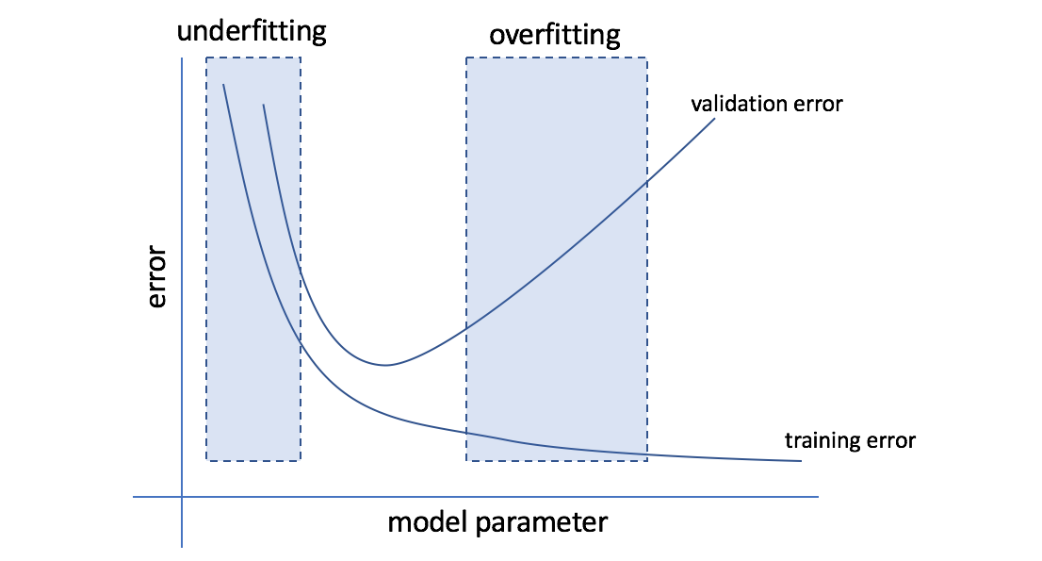
Another Way to look at the trade off

Slide 22
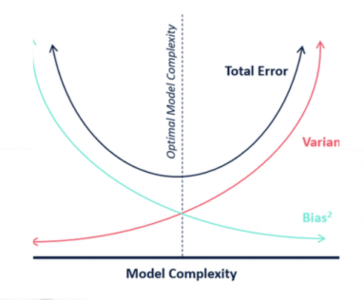
Bias-Variance Tradeoff
Bias occurs when a model is strictly ruled by assumptions
If your model assumes linearity (LR/DT), including features with non-linear relationships → bias ↑ → underfitting
Variance is high when a model focuses on the training set too much and learns the variations very closely.
High variance → sign of overfitting
Optimal: intersection of bias/variance curve
We favor low Variance!!!

Slide 23
Bias and Variance
Bias: model does not learn enough from the training data
Aka. underfitting
Do you have enough training data?
Do you include all relevant features?
Variance: model learns too much from the training data
Aka. overfitting
Model learned from noise? Clustering? Anomaly detection?
Feature selection/engineering?

Slide 24
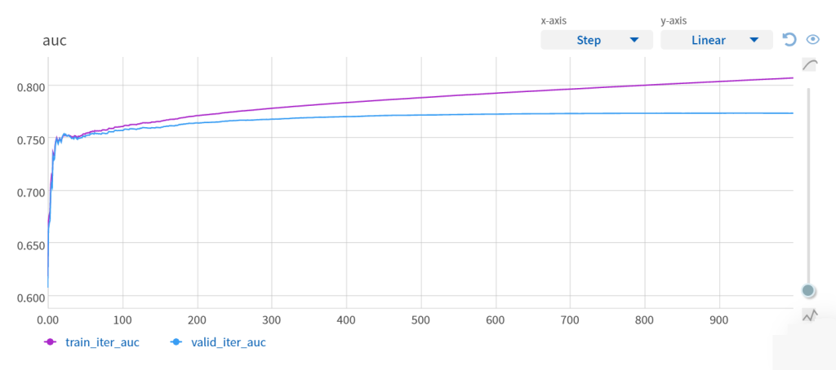
Learning Curve - more for Model Optimization
a learning curve is a way to track the learning or improvement in model performance on the y-axis and the time or experience on the x-axis.
Only available for boosting/neural nets

Slide 25
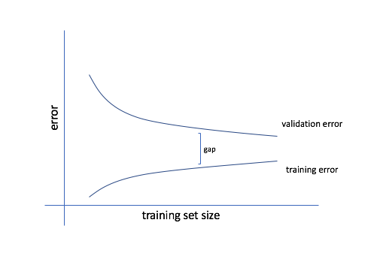
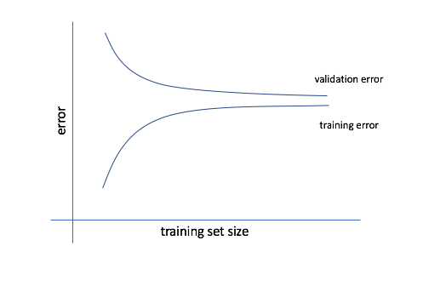
Tie Learning Curve to Bias/Variance Tradeoff
High Bias
High Variance

